Slide 1
Quantum Device Design Workshop 2025 May 19-22 UCLA
Eli Levenson-Falk
University of Southern California

Slide 2
Workshop Goals
Teach basic design techniques to beginners – formalize the hidden education that’s in some labs
Ideally a model for future work – there should be a textbook for this!
Spread advanced techniques to experts – design is its own discipline and deserves to be given full attention!
Figure out what research problems need attention, what resources need to be developed, who can contribute to what
Report out to funding agencies and hopefully get some support for important work!

Slide 3
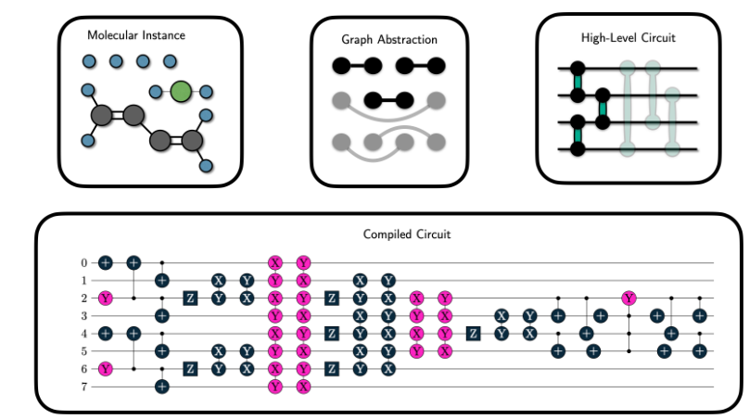
The Design Problem
“Can you please make me something that does this? Look, I already did all the work to figure out the gate sequence, you just need to make me something that runs those gates!”
Kottmann Quantum 2023

Slide 4
The Design Problem
“OK OK, I’ll give you something closer to the hardware. Please make me this Hamiltonian.”
$$\hat{H}=\sum_{m}{\left[−\frac{ω_{m}}{2}σ_{m}^{z}+Ω_{m}^{x}\left(t\right)σ_{m}^{x}+Ω_{m}^{z}\left(t\right)σ_{m}^{z}\right]}+\sum_{m,n}{\left(J_{mn}^{xx}σ_{m}^{x}σ_{n}^{x}+J_{mn}^{xz}σ_{m}^{x}σ_{n}^{z}+J_{mn}^{zz}σ_{m}^{z}σ_{n}^{z}\right)}+…$$

Slide 5
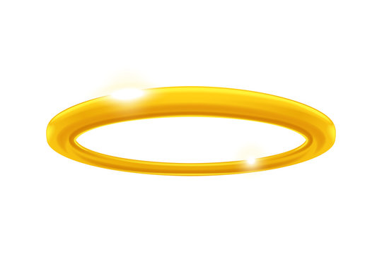
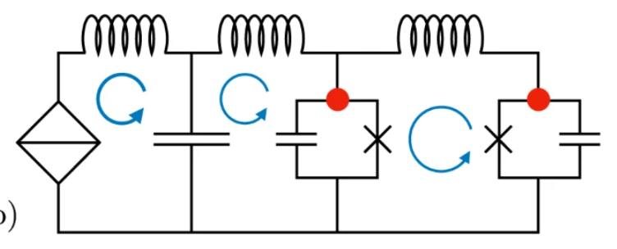
The Design Problem
“Hi, it’s me, your favorite theorist. Can you make a device that implements this circuit?”
Koliofoti and Riwar npj QI 2023

Slide 6
The (Inverse) Design Problem
Given a desired device behavior, how do we create a physical layout that implements it?
Hamiltonian Space
Design Space

Slide 7
Design process overview
Figure out the circuit graph you want
Does a physical layout element exist that implements it? If not, invent it.
Create a layout
Plug into EM simulator, turn all the accuracy hyperparameters up as high as you can tolerate ($$$)
Extract circuit graph and/or effective Hamiltonian
Iterate until simulation hits target
Do one more extra-accurate simulation at the end just to confirm
…

Slide 8
Design process overview continued
Adjust your design to account for fab bias
Send to fab team
($$$)
Do room temperature testing to ensure fab went ok
Cool down, do complete characterization
($$$$$$)
Find out simulations weren’t accurate or it wasn’t the ideal design
Back to design, simulate, iterate, etc.

Slide 9
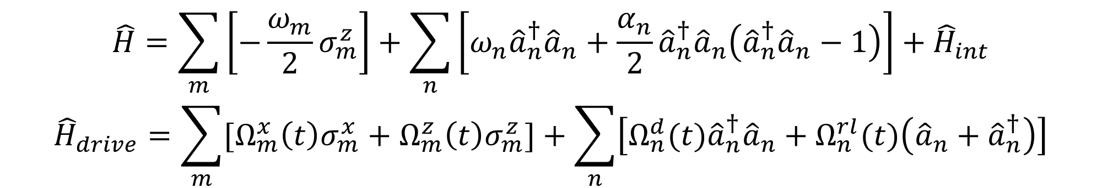
Effective Hamiltonian
$$\hat{H}=\sum_{m}{\left[−\frac{ω_{m}}{2}σ_{m}^{z}\right]}+\sum_{n}{\left[{ω_{n}\hat{a}}_{n}^{†}{\hat{a}}_{n}+\frac{α_{n}}{2}{\hat{a}}_{n}^{†}{\hat{a}}_{n}\left({\hat{a}}_{n}^{†}{\hat{a}}_{n}−1\right)\right]}+{\hat{H}}_{int}$$
$${\hat{H}}_{drive}=\sum_{m}{{[Ω}_{m}^{x}\left(t\right)σ_{m}^{x}+Ω_{m}^{z}\left(t\right)σ_{m}^{z}]}+\sum_{n}{\left[Ω_{n}^{d}(t){\hat{a}}_{n}^{†}{\hat{a}}_{n}+Ω_{n}^{rl}(t)\left({\hat{a}}_{n}+{\hat{a}}_{n}^{†}\right)\right]}$$
Treat system as a finite collection of modes with various couplings between them
Treat all modes as harmonic oscillators, anharmonic oscillators, or qudits
Treat drives as either diagonal or raising/lowering, with strengths calculated beforehand (stay tuned)
Good for designing gates, modeling device behavior, fitting to data

Slide 10
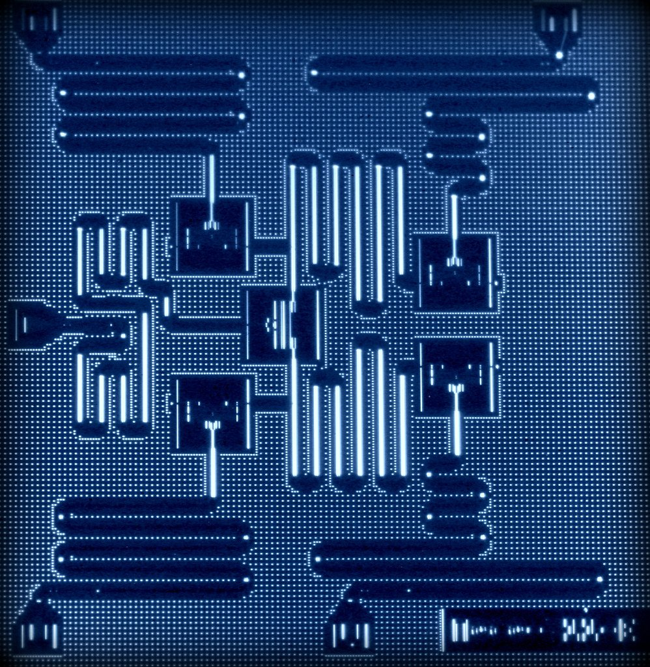
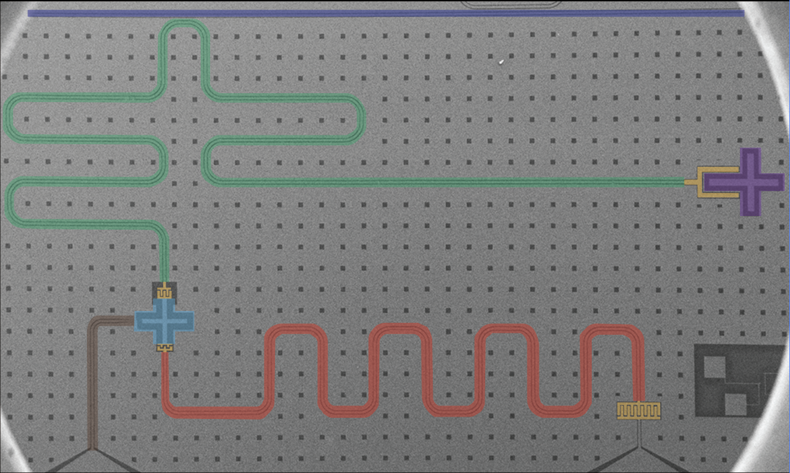
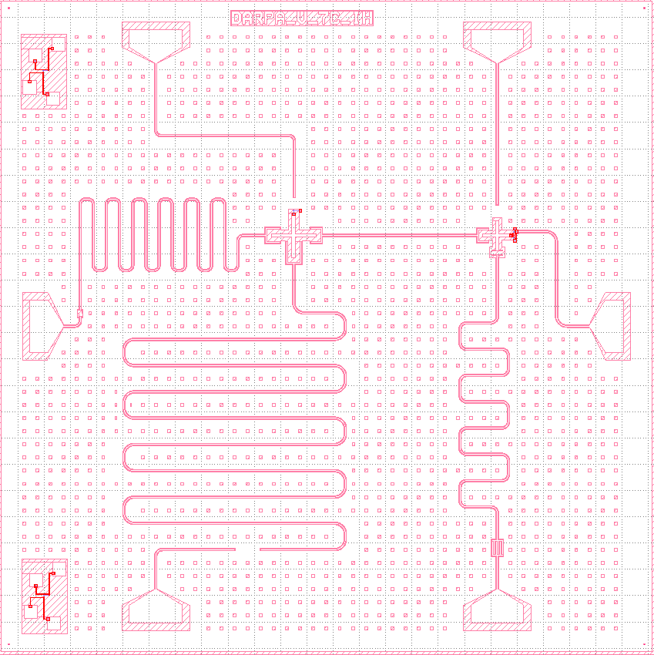
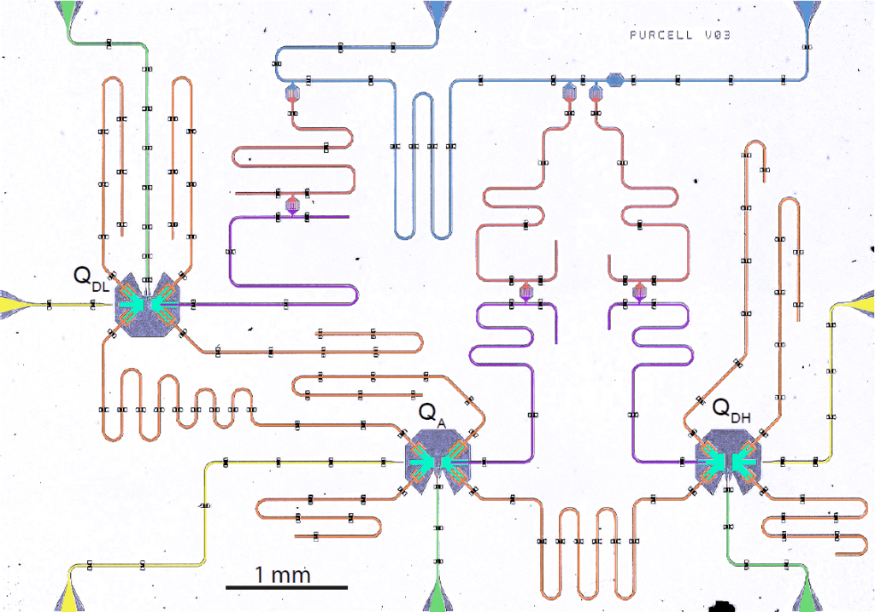
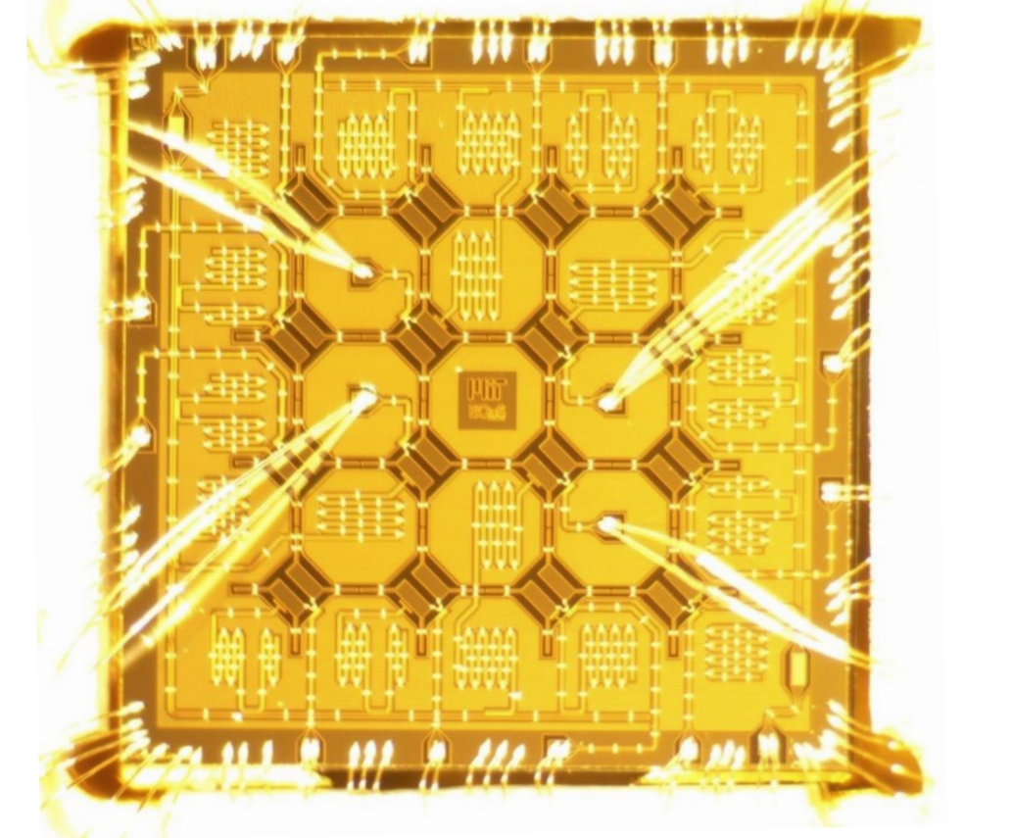
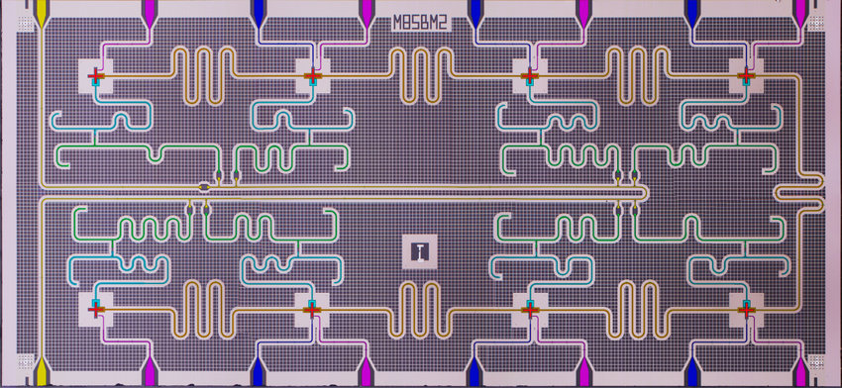
Device Layout

Slide 11
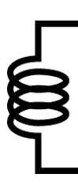



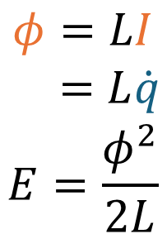
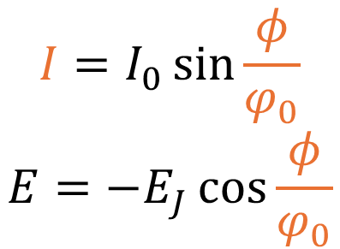

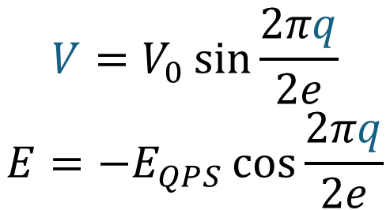
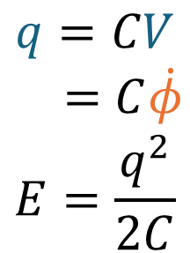

Circuit Graph
Inductor Capacitor Josephson junction Quantum phase slip junction
$$q$$
$$q$$
$$φ$$
$$φ$$
$$φ=LI$$
$$=L\dot{q}$$
$$E=\frac{φ^{2}}{2L}$$
$$q=CV$$
$$=C\dot{φ}$$
$$E=\frac{q^{2}}{2C}$$
$$I=I_{0}\sin{\frac{φ}{φ_{0}}}$$
$$E={−E}_{J}\cos{\frac{φ}{φ_{0}}}$$
$$V=V_{0}\sin{\frac{2πq}{2e}}$$
$$E=−E_{QPS}\cos{\frac{2πq}{2e}}$$

Slide 12
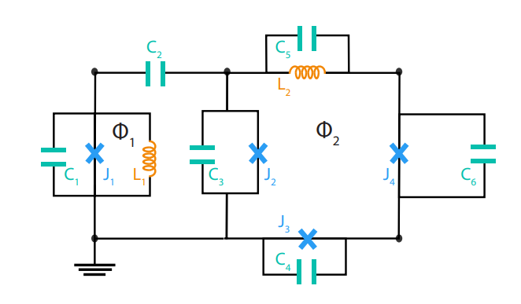
Circuit Graph

Slide 13
Circuit Graph
Also have transmission lines, superinductors—reduce to effective lumped models
Only an approximation – literally every object is distributed, everything has capacitance to everything else, everything has mutual inductance
This is the level most designers think at
Pahls will talk about general techniques for this

Slide 14
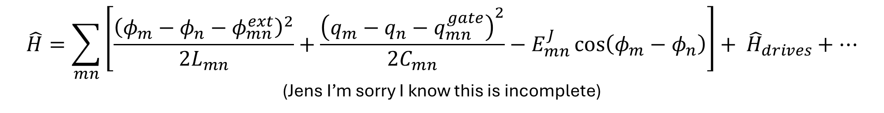
Circuit Hamiltonian from Graph
$$\hat{H}=\sum_{mn}{\left[\frac{{\left(φ_{m}−φ_{n}−φ_{mn}^{ext}\right)}^{2}}{{2L}_{mn}}+\frac{{\left(q_{m}−q_{n}−q_{mn}^{gate}\right)}^{2}}{2C_{mn}}−E_{mn}^{J}\cos\left(φ_{m}−φ_{n}\right)\right]}+ {\hat{H}}_{drives}+…$$
(Jens I’m sorry I know this is incomplete)
This is really hard!
Many techniques exist, not all are general (QPS junctions and nonreciprocal devices make things hard)
Michel Devoret will discuss this in detail this later

Slide 15
Effective Hamiltonian from circuit Hamiltonian
Quantize the circuit into well-defined modes with mode operators
Define any drive operators in terms of mode operators
Diagonalize, transform, Floquetize, etc.
This can be really really hard!
Jens Koch will discuss this more in his talks

Slide 16
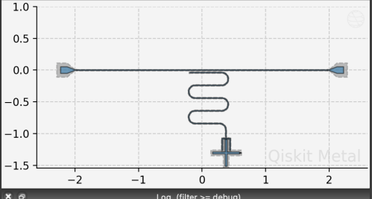
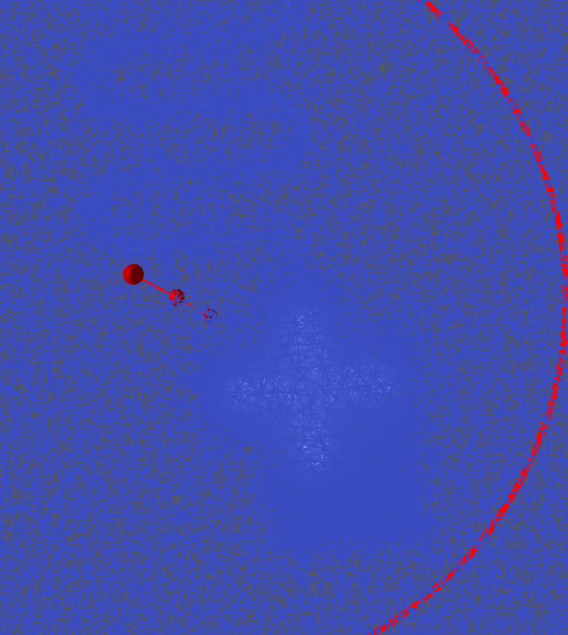
Circuit Graph from Layout
Solve EM behavior numerically, use it to construct graph (or jump straight to effective Hamiltonian—see later talks)
One of the biggest challenges! Very computationally intensive, easy to get wrong, need to develop ways to solve this for much larger systems without just throwing RAM at the problem
Murat, Shanto, Ben will all discuss this later in great detail and will run workshops showing how to do this

Slide 17
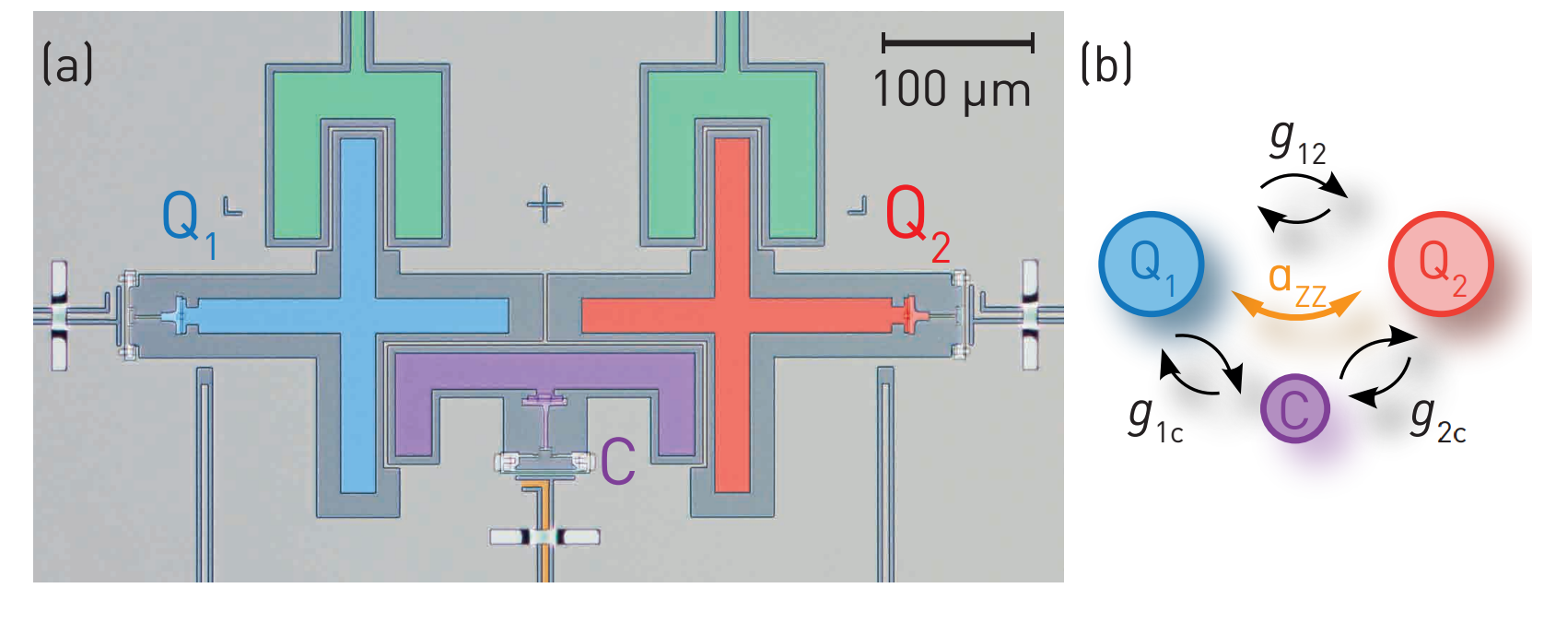
Coupling and Readout
Can’t just have isolated qubits—need to couple capacitively/inductively/galvanically
Typically the couplings we want emerge as limits of the couplings we have (e.g. dispersive from transverse)—need to engineer to cancel unwanted terms
Andreas Wallraff, Daniel Sank, Ofer Naaman will discuss
Collodo et al. PRL 2020

Slide 18
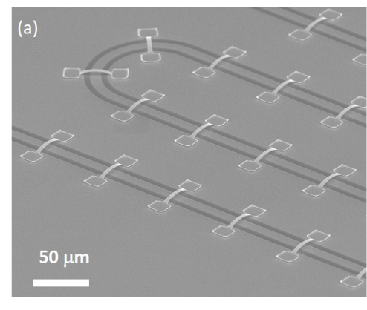
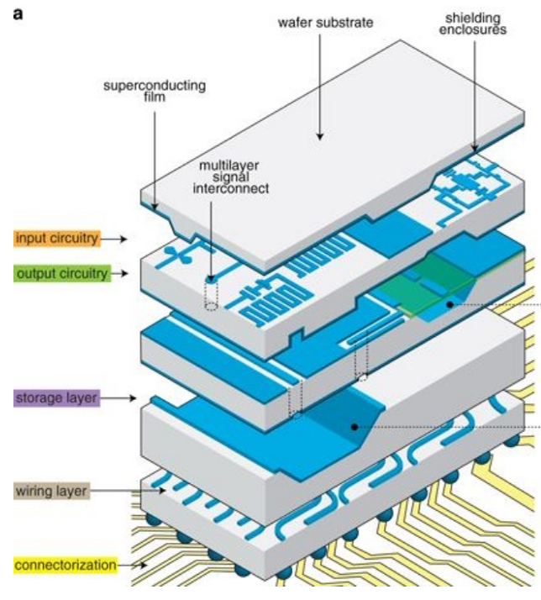
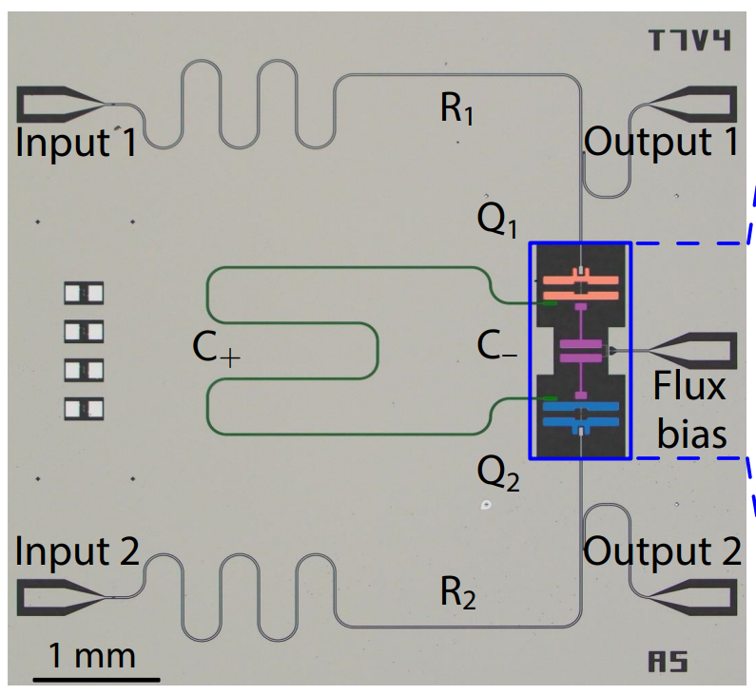
Crosstalk
Classical (microwave): drive mode A, field reaches mode B (might be physically distant!)
Quantum: unwanted effective Hamiltonian terms
In tension with coupling!
Ben Jarvis-Frain will discuss
Rosenberg et al. IEEE Magazine 2020
Mundada et al. PRApplied 2019

Slide 19
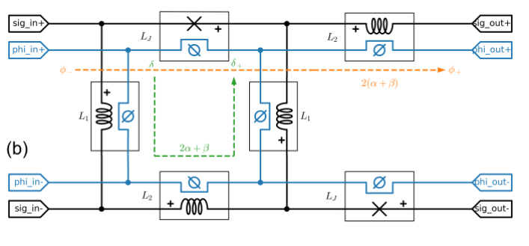
Superconductivity
A superconductor isn’t just a perfect conductor:
Kinetic inductance
Flux focusing and finite penetration depth
Flux quantization
Phase slips
Ofer Naaman and Hakan Türeci will talk about this a lot
Naaman et al. arXiv 2025

Slide 20
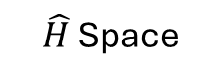
Efficient design and simulation
$\hat{H}$ Space
Design Space
Can’t just simulate whole QPU, tweak one thing, simulate again, over and over – need to somehow build things up
Large full-chip simulations may not even be possible at the level of precision required
We are trying to map design space to effective Hamiltonian space, and we don’t know the map – perfect situation to use ML!
Sadman Shanto will talk about this

Slide 21
Logistics
If all that sounded very familiar, head on over to the advanced session. Otherwise, try out the beginner session—you can always switch back!
You should already have installed Qiskit Metal, SQuADDS, SQDMetal, Palace – if you haven’t, come talk to us at lunch!
Breaks and lunch will be in and around Tesla room (no food or drinks in Shannon room, sorry)
Breakout sessions: small groups to discuss a particular advanced topic. Already planned:
Qiskit Metal (and SQuADDS?) maintainers groups
Design education resource creation
Workshop Year 2 planning
Quantum beers this afternoon!

